Slide 1
Touch Screens
Presented by: Sadia, Hooria Sajid

Slide 2
Outline:
Definition
Types of Touch Screen
Capacitive touch screen
Resistive touch screen
Surface Capacitive Touch Screens
Projected Capacitive (P-Cap) Touch Screens
SAW (Surface Acoustic Wave) Touch Screens
IR (Infrared) Touch Screens
Optical Touch Screens
Conclusion

Slide 3
Definition
A touch screen is a display screen that allows users to interact with a device by touching the screen directly with their fingers or with a stylus pen.
The screen is usually made up of multiple layers, including a transparent electrical conductor layer, a protective glass or plastic layer, and a display panel.
When a user touches the screen, the electrical current is disrupted at that location, which is detected by the touch screen controller.
The controller then communicates the touch coordinates to the device's software, which then interprets the touch as a specific action or command.
Touch screens are commonly used in smartphones, tablets, laptops, and other electronic devices.

Slide 4
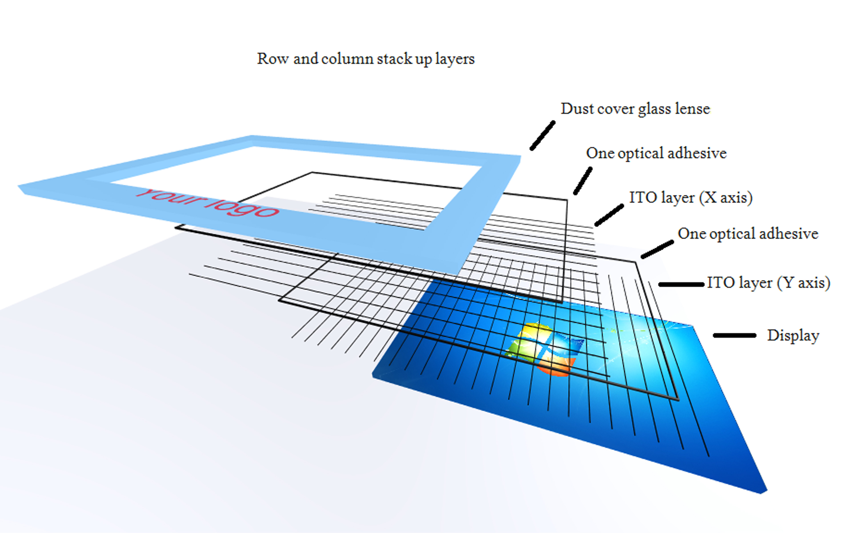
Capacitive touch screen
The capacitive touchscreen is the most commonly used type of touch screen technology.
It uses a transparent conductor to create a grid of electrical charges.
When your finger or stylus comes into contact with the display, it disrupts this charge grid and sends a signal to the device’s processor.

Slide 5
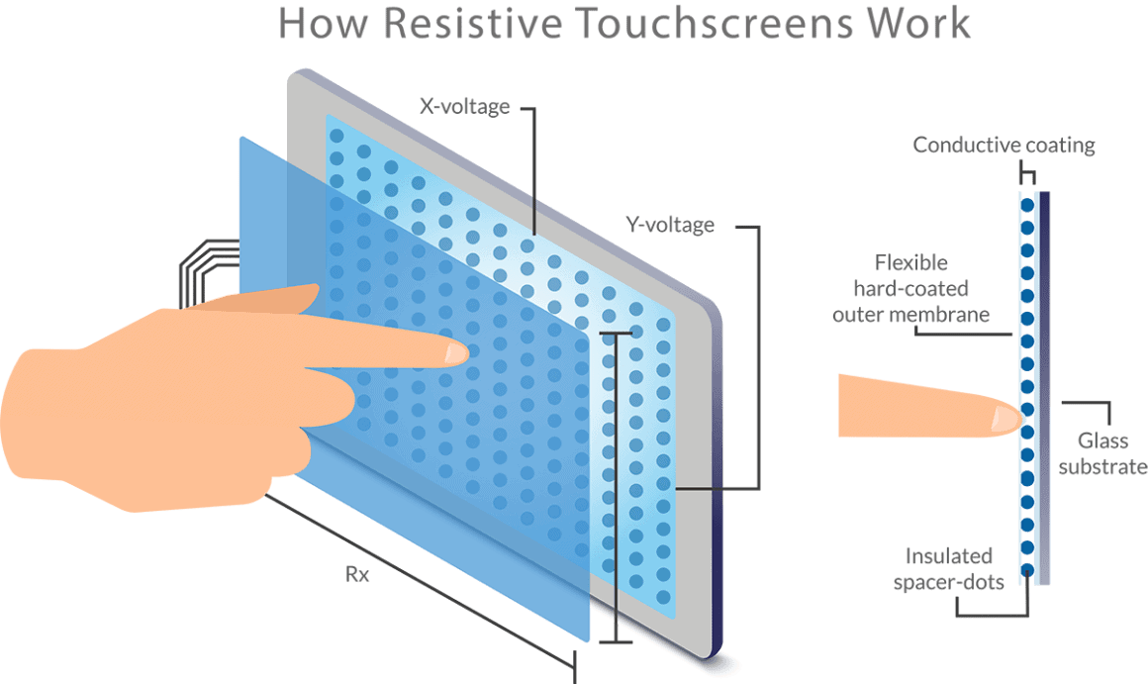
Resistive touch screen
This type of screen uses pressure to register a touch on the screen.
There is no need for special gloves or other tools to use this type of screen.
However, moisture and dust can interfere with its ability to work properly.
This type of touchscreen may not be as accurate as others because there is less room for error when using it due to the nature of the technology behind the resistive touchscreen itself.

Slide 6
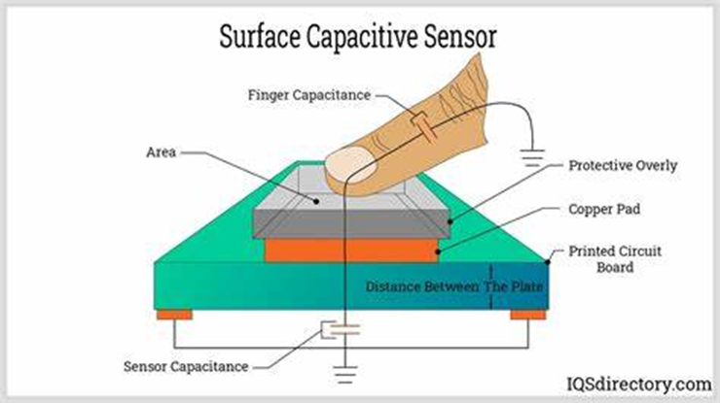
Surface Capacitive Touch Screens
Surface capacitive touch screens are touch screen displays that respond to the presence of a human finger.
This type of screen is often used in portable electronic devices such as smartphones and tablet computers.
Surface capacitive touch screens are made up of a number of layers.

Slide 7
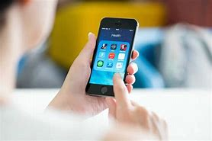
In Cell Touch Screen
In-cell technology refers to a standard in which touchscreens are designed with an integrated display and digitizer layer.
In other words, they have a single layer that features both the display and digitizer.
In-cell technology allows for a smaller and slimmer design, improved visual clarity and a lower weight.

Slide 8
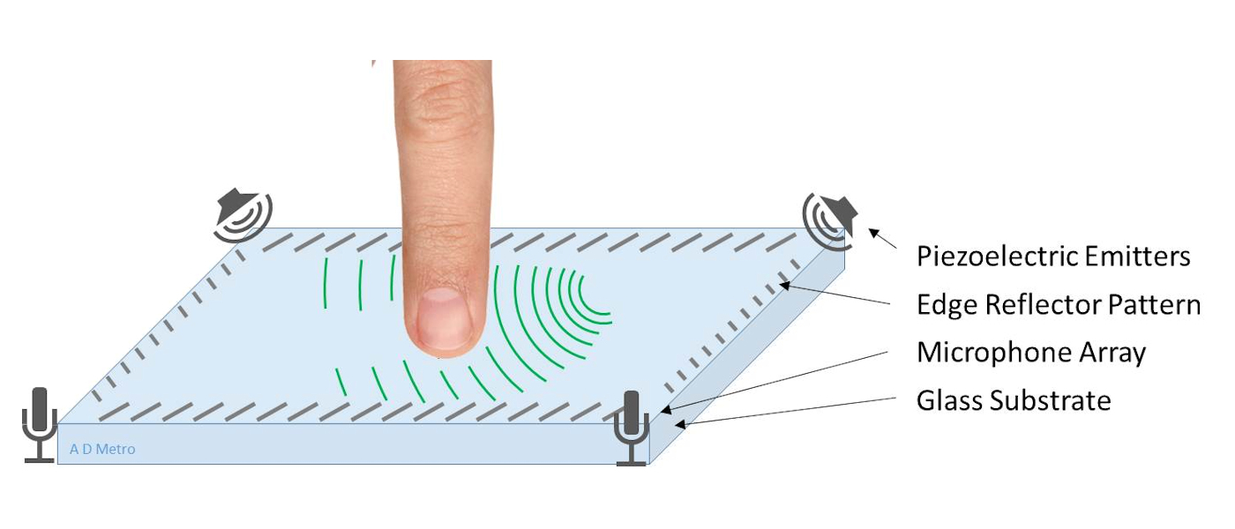
SAW (Surface Acoustic Wave) Touch Screens
SAW (Surface Acoustic Wave) touch screens are a type of touch screen technology that is used in many devices, including smartphones, tablets and computers.
They are different from capacitive touchscreen displays because they use sound waves that are sent through the surface of the screen.
This allows you to move your finger along with an object on-screen, such as a cursor or item in an app, without physically touching it.

Slide 9
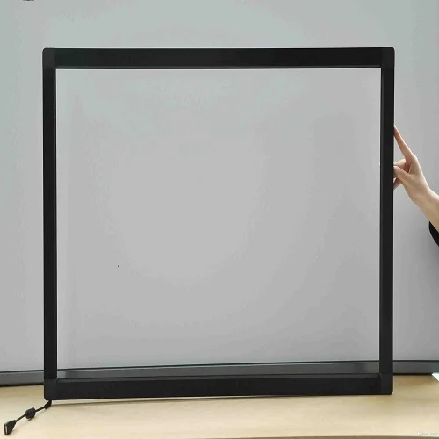
IR (Infrared) Touch Screens
Infrared touch screens are an alternative to standard touchscreen technology.
Infrared touch screens use a camera that detects the infrared light emitted by your finger on the screen to determine where you’ve touched.
This allows for more precise gesture recognition, which is important for applications like gaming and medical devices.

Slide 10
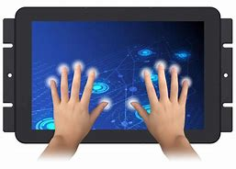
Optical Touch Screens
Optical touch screens use optical sensors that are placed around the edges of the screen to detect and track the movement of a user's fingers or other input devices.
These sensors emit infrared light beams across the surface of the screen, and when a finger or object touches or interrupts the beams, the system detects the location and movement of the touch.

Slide 11
Conclusion
In conclusion, touch screens have revolutionized presentation methods by offering interactive and engaging experiences.
Touch screens have enhanced the overall delivery of presentations by promoting audience engagement, enabling real-time collaboration, and providing a more immersive experience.
With their ease of use and flexibility, touch screens have become an indispensable tool for presenters, enabling them to deliver impactful and memorable presentations.

Slide 12
Thank You

